Slide 1


Slide 2
Target
Target
Our target - university students between 19 and 25 years old
We deployed a form with a series of questions to collect different points of view from our future users.

Slide 3
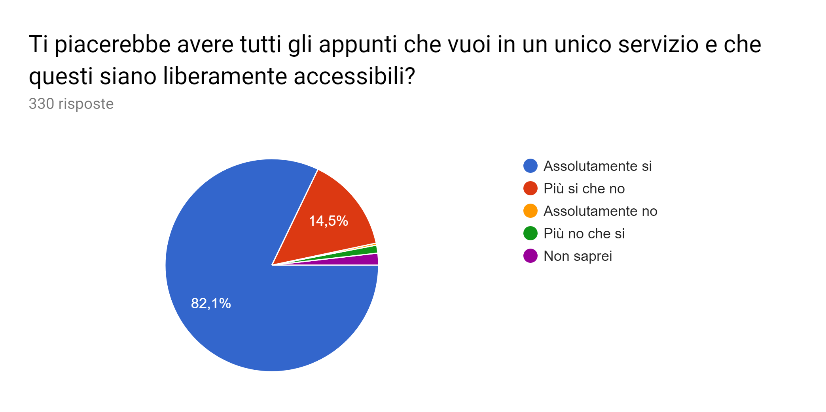
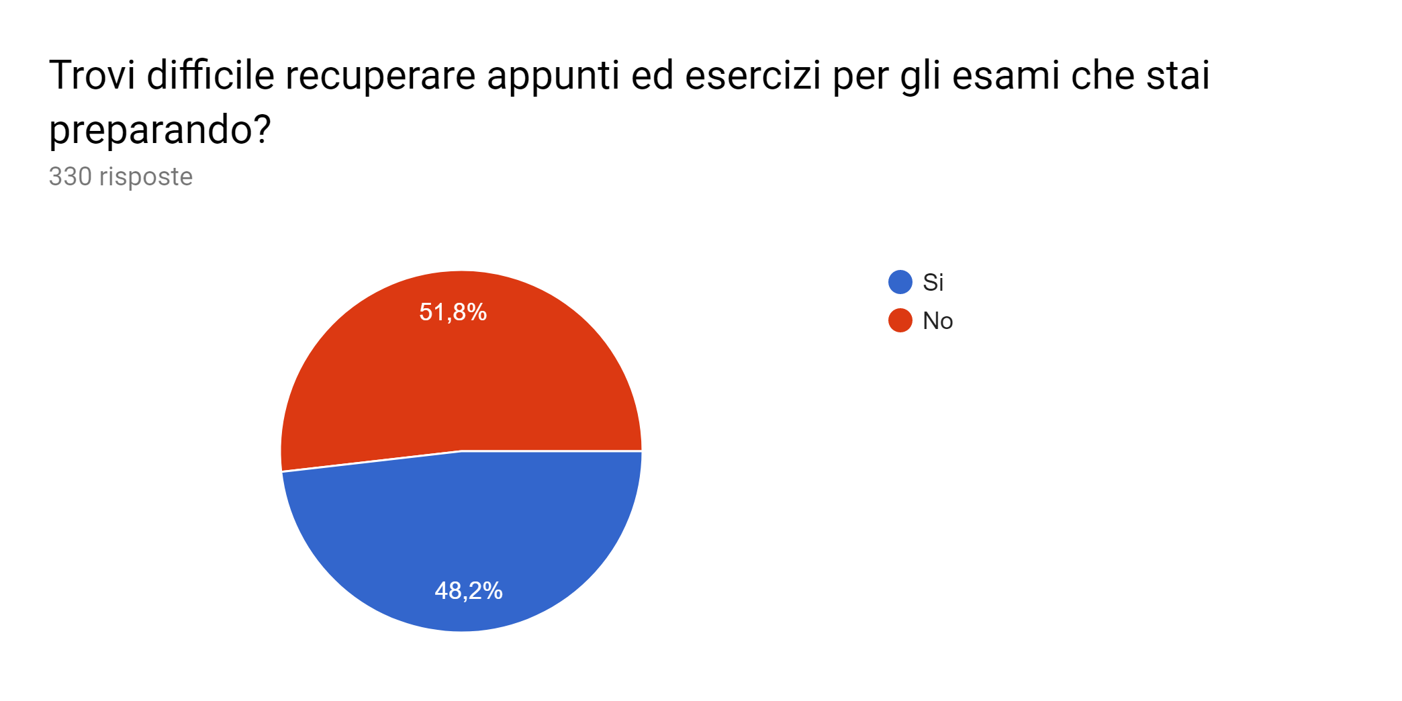
Data analysis
Data Analysis

Slide 4
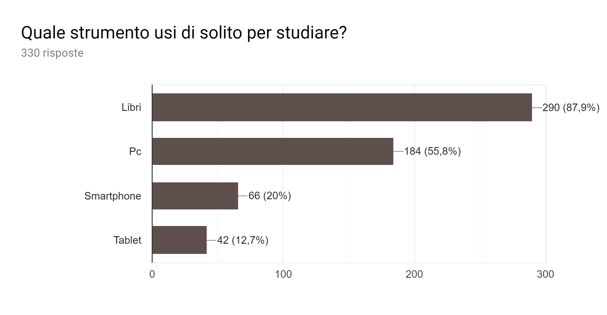
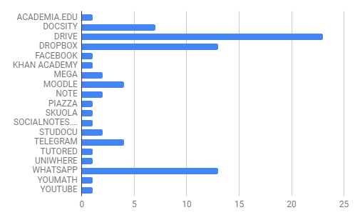
Data Analysis

Slide 5
Needs
Needs
Difficulty in finding notes
Slow and inefficient research of notes
Not-homogeneous quality of notes

Slide 6
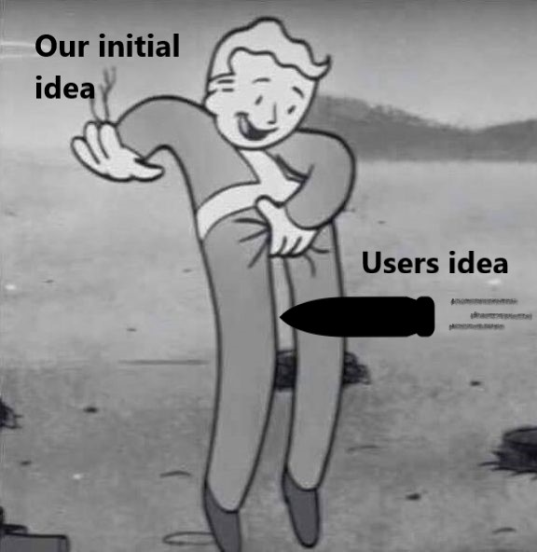

Possible solution
Possible Solution

Slide 7
...ok really
...ok really
Free service
Good indexing of notes
Ease on finding notes also from other Universities
Evaluation system of notes

Slide 8
Main features SEE WIKI
Main Features
Note Mashup
Initially manual, will create on request a mashup of the best notes regarding one subject. in future will manually regroup their favourites notes in one file.
Notes evaluation based on: users rating, # downloads, time spent on the note
Roadmap
Milestone #2: manual implementation
Milestone#3: automatic implementation

Slide 9
Main features SEE WIKI
Main Features
Automatic management of tags
Documents search based on Tags
Documents stored according to Tags
Roadmap
Milestone #2: manual implementation
Milestone#3: automatic implementation

Slide 10
Main Features
Digital Sign of Notes
System will mark a posted document with a digital sign that will prevent the storage of copies in the databases.
Roadmap
Milestone #2: code available

Slide 11
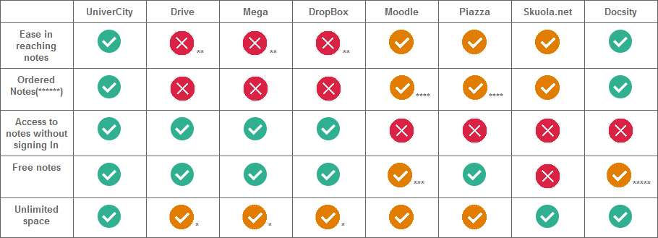
Competitors
* it’s possible to buy more space
**sometimes to reach a resource it’s necessary to receive the authorization from the owner
***it’s free, but only students from “La Sapienza” can use it
****sorted by class only
*****alphabetical order of notes
******efficient indexing (tag)

Slide 12
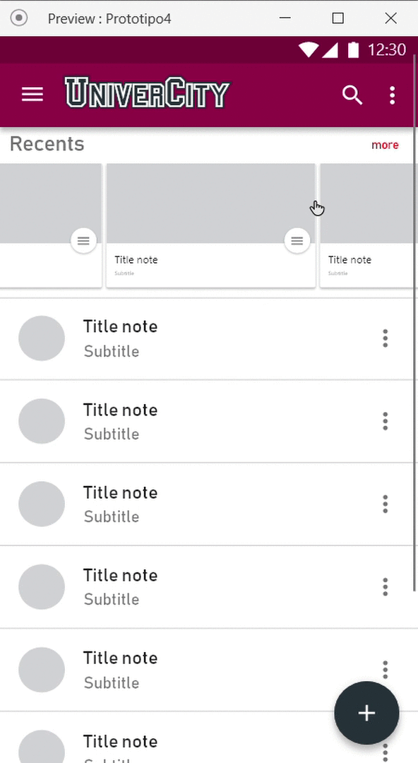
Scenarios
I want to search for notes that I can’t find anywhere else, and filter them by University, Faculty, Professor etc. Can I?

Slide 13
Scenarios
I want to upload some notes saved on my device. I also want to upload a note that I just wrote on paper. How can I do?

Slide 14
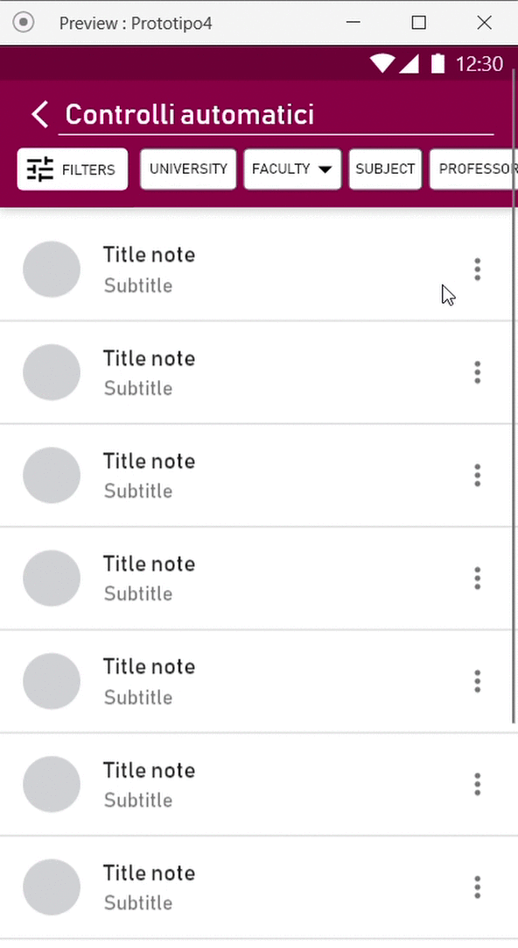
Scenarios
I want to save a note as a favourite and I want to see it anytime without downloading it. Can I?
I just found this note and I want to share it with a friend through a link. Is it possible?

Slide 15
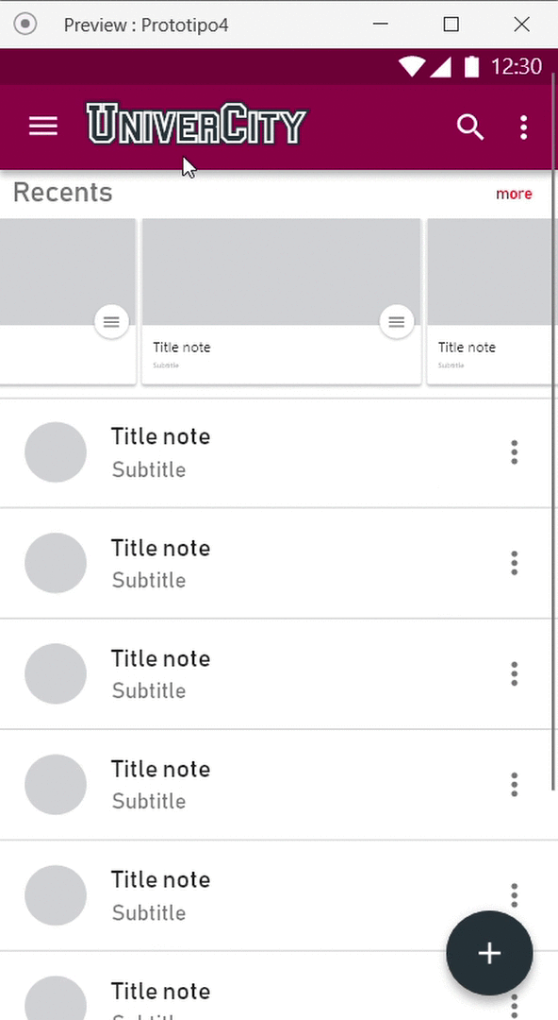
Scenarios
I read a note a few days ago, but I don’t remember its name or who wrote it. Can I recover it?

Slide 16
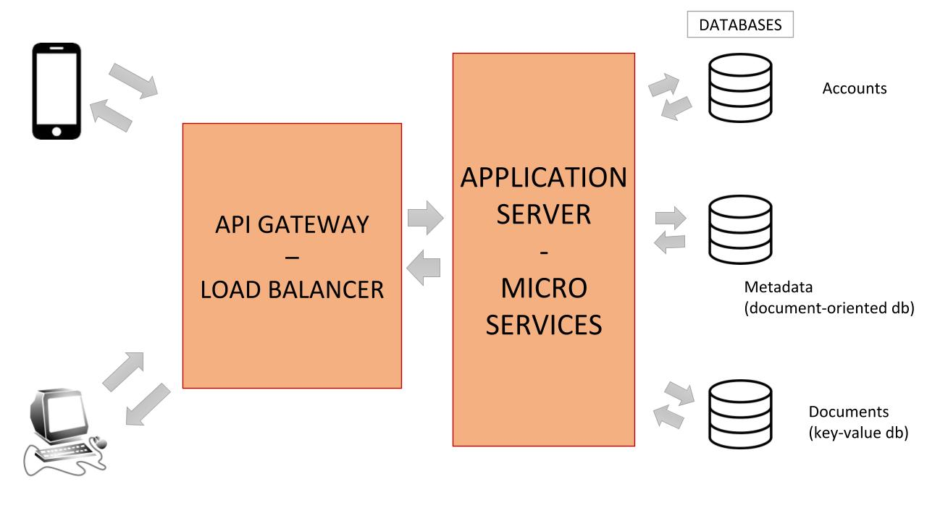
Architecture
A service that will act as API Gateway, Load Balancer and a proxy Server for environment’s security
We chose a micro services based application servers layer

Slide 17
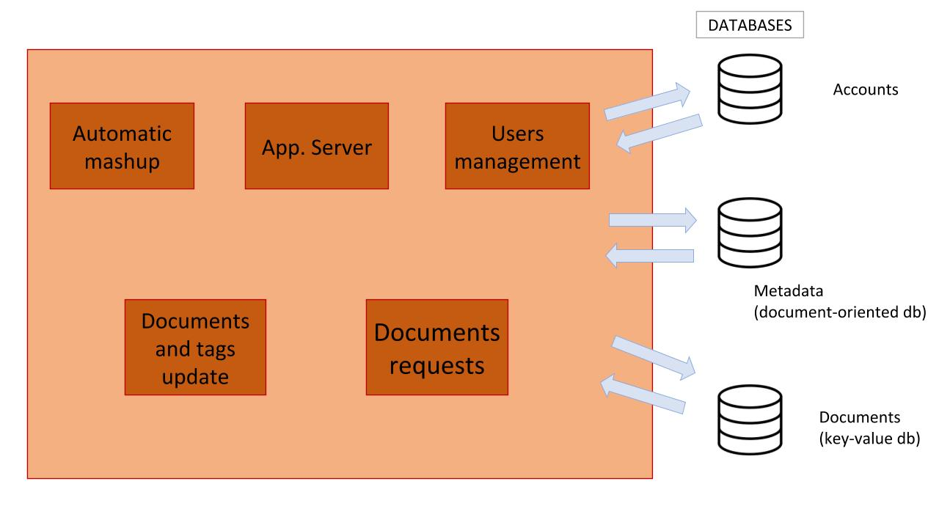
Architecture
App Server: manage the page request
User Management: sign up and sign in process.
Automatic Mashup: can mashup different notes.
Document Request: return a document on request.
Docs and Tag Update: will update docs and relative metadata, including removal.

Slide 18
Our team
TIZIANO COLAGROSSI
Milestone #1
Mockup
Presentation
Survey
Data Analysis
Next milestone:
Web & App Design
App Client Development
COLLALTI MARCO
Milestone #1
Survey
Data Analysis
Next milestone:
Client-Server interaction
DAVIDE BRIAN DI CAMPI
Milestone #1
Survey
Data analysis
Github management
Next milestone:
Client-server interaction

Slide 19
Our team
DILOLLO MICHELE
Milestone #1
Survey
Competitors research
Architecture analysis
Next milestone
Database development
Microservices development
MEDRIHAN LUCIAN
Milestone #1
Survey
Mockup
Next milestone:
Web & App Design
Web client development
PAGLIUCA RICCARDO
Milestone #1
Survey
Architecture analysis
Next milestone
Database development
Microservices development

Slide 20
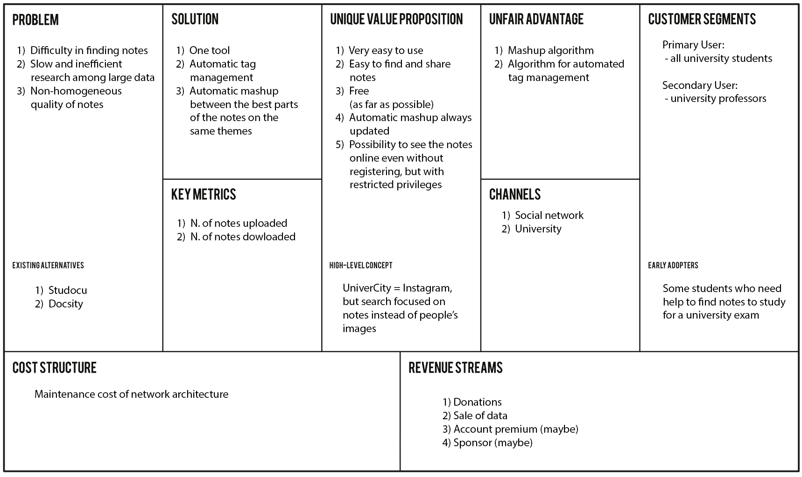
Contacts
Lean canvas (something old and something new)

Slide 21
Contacts
Contacts & links
Email - univercitystats@gmail.com
GitHub - https://github.com/davidedc97/UniverCity.git
Interactive mockup (mobile) - here
Interactive mockup (web) - here
Online slides with animated scenarios - here

